Slide 1
An Advent Reflection

Slide 2
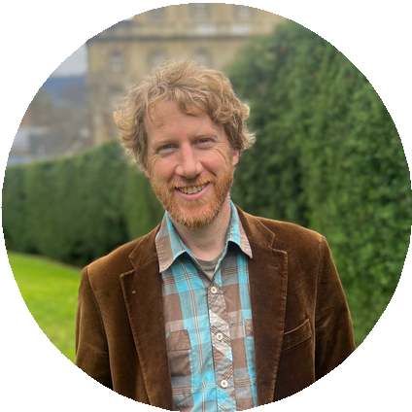
whole biblical story anticipates with many promises and signposts.
During advent, we ready ourselves to celebrate the incarnation, the extraordinary arrival of God in the person of Jesus! We also remember that the one who was born at Christmas will one day return, making all things new! We ourselves are in a time of waiting, living our lives in this world of many troubles, working for good and yearning for God’s kingdom.
In this series of reflections, we look back to the book of Ruth, set in none other than Bethlehem.
I call these studies the Bethlehem Prequel, for they demonstrate how God was preparing us for the coming of Jesus in times of old!
Ruth consists of just four chapters. It is a beautiful and intimate book set during a transition period, in the generations
Kim Beales is the minister at St Mark’s Anglican Church, Bellerive, Tasmania. He is also a songwriter and Christian communicator.
Advent & the Bethlehem Prequel
Advent is a time of anticipation. When parents wait for the birth of their child, this is a kind of advent period. In the Christian story, the first great period of advent anticipation concerns the arrival of the Messiah. This is not an arrival that was to come out of the blue, but an arrival that was being prepared for us from the beginning of time, which the

Slide 3
that preceded the monarchy in Israel. We see God’s wonderful provision in the context of an immensely personal story. In reflecting on the book of Ruth, I have found that it fits extraordinarily well with the work of Anglican Overseas Aid.
I pray that you find these reflections enriching and that they lead you to marvel at the wonder of God’s heart and purposes.
Kim Beales
To make the most of these studies, I recommend that you:
Week 1. The House of Bread
Take time to read the relevant chapter in Ruth
Week 2. Wings of Refuge
Prayerfully pause to reflect on the story and its significance
Week 3. Scandal and Honour
Read the reflection I have written in our study guide
Week 4. Jesus’ Family Tree
And finally, respond to God in prayer, with a readiness for action as we ourselves participate in the story of God.

Slide 4
The House of Bread
Ruth 1:1-22
The book of Ruth begins in Bethlehem in the time of the judges. Bethlehem means ‘house of bread’, yet at the beginning of Ruth, things are amiss, for there is famine in the land. The famine is twofold. There is literal hunger in the land, yet there is also a famine in regard to godly leadership in a time in which ‘everyone did as they saw fit’ (Judges 21:5).
refugees. Further trouble awaits them in Moab, for Naomi becomes a widow, and both her sons also die.
In the course of time, Naomi hears that God has ‘come to the aid of his people by providing food for them’. She prepares to make her voyage home, urging her Moabite daughters-in-law to remain with their mothers. Ruth famously replies, ‘Where you will go I will go; where you lodge I will lodge. Your people shall be my people, and your God my God.’ Here, this young foreign widow displays exemplary love and loyalty, embracing not only Naomi but also her people and God.
In the book of Ruth, God weaves together his purpose of provision, which is at once economic, deeply personal, and ultimately for the salvation of the world.
Elimelech and Naomi depart Bethlehem, the ‘house of bread’, and travel to Moab in hope of food and a livelihood. They could be described as economic
In the midst of loss and famine, the hope in our first chapter is that God is bringing

Slide 5
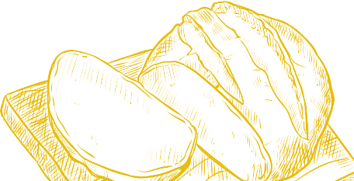
food back to the land. Naomi and Ruth arrive in Bethlehem at the beginning of the barley season with the first crop ready for harvest. The house of bread is returning to normal, for there is food in Bethlehem! Yet even more than bread, God was preparing provisions that would satisfy humanity’s deepest need.
Here, the one who called himself ‘the bread of life’ was born!
Response: God continues to care deeply about feeding those who are hungry.
How can you provide physical, social or spiritual sustenance for others?
Lord God, this advent, we pray for people around the world who need a meal. As we prepare our festivities, may we share our food lavishly with those who need it most. May we, as a people, be like a house of bread, sharing the
message of Christ and working towards a world where there is food for all. Amen
The hope of Christmas also begins with two women, one older and one younger. One has known the sorrow of childlessness, and the other is a young and faithful servant of God. Their names are Elizabeth and Mary. To the elderly Elizabeth, God gives a miracle child, John the Baptist, and to Mary, God gives the even greater miracle of the virgin birth. Caesar decrees a census, such that Joseph, descended of David, together with the young and pregnant Mary, return to Bethlehem, the house of bread.

Slide 6
Hope in drought
Our partner in Kenya, The Anglican Church of Kenya, Mt Kenya West Diocese, is reaching out to the most vulnerable people impacted by the drought.
Cucu, a grandmother, explains her first encounter with the Diocese, ‘The Bishop came with Millicent… they gave us food. That day, most of us would have slept hungry. The pastor gave us hope and promised to walk with us until our lives improved.’
A savings group of 52 women and two men formed and are working towards their shared vision to purchase a piece of land. With the support of Millicent’s team, they are being trained in developing a savings group, livestock management, early warning signs of drought, water harvesting, and identifying locally available resources and opportunities to enhance their livelihoods.
One member has been selling vegetables with a loan from the group savings; she has been able to pay it back and earn a profit. She says it gives her a feeling of being useful and has reduced overreliance on her husband, giving her new confidence and pride.

Slide 7
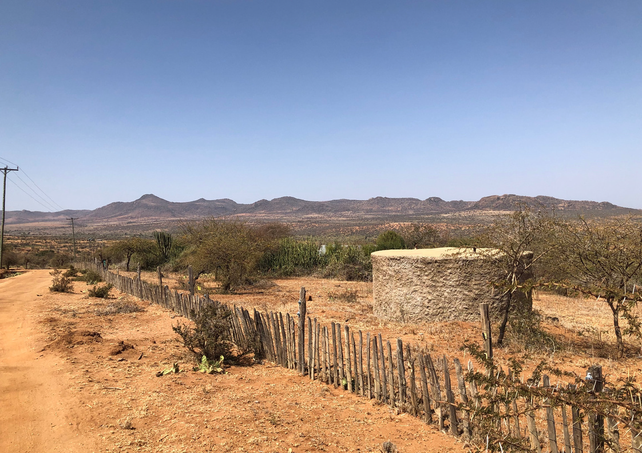
‘The pastor gave us hope and promised to walk with us until our lives improved.’
A photo taken by AOA’s CEO Jo Knight, on her recent visit to Kenya

Slide 8
Wings of Refuge
Ruth 2:1-23
Ruth is a story of profound honour and love. Where last week we saw the love of Ruth for her mother-in-law, here we see love being expressed in the actions of Boaz. In a world in which people can pursue profit at all costs, the Old Testament law intentionally placed limits, including a law that the edge of the harvest field was to be left for the poor, the widow, and the foreigner to glean.
Firstly, he calls Ruth, ‘my daughter.’ This is significant for Ruth is a vulnerable young woman and a foreigner. The mistreatment of vulnerable women is one of the deep tragedies of human life. Boaz speaks to Ruth with honour and respect, without a trace of racial or sexual discrimination. Furthermore, he is savvy to the ways of the world, and takes active initiative, setting a culture of respect in the workplace.
Boaz greets his workers, ‘the Lord be with you’. Soon we discover that Boaz’s expression is not merely a greeting but a posture towards life. If we were to look for a case study of genuine personal and workplace integrity, we would do well to observe Boaz. He demonstrates genuine ethical behavior when he discovers Ruth gleaning in the fields.
Boaz does not fulfill the law by doing the minimum duty; he goes beyond, inviting Ruth to drink from the water jars the men have filled. Ruth asks why Boaz has acted so kindly. He tells her that he has heard her personal story of devotion to Naomi and says, ‘May you be richly rewarded by the Lord, the God of Israel, under whose

Slide 9
wings you have come to take refuge.’ In his kindness towards Ruth, he becomes a participant in God’s refuge.
Response: When have you felt the shelter and hope of God in difficult times?
In the coming of Jesus at Christmas, God is bringing us refuge. When Jesus greets us, he not only recognises the presence of God, he is God’s presence! He, too, addresses many vulnerable women as daughters. He, too, goes beyond what is required in the law, giving himself for us, even unto death. Just as Boaz was a ‘guardian-redeemer’ who embraced his responsibility to care for his relatives in poverty, at Christmas, we celebrate the birth of Jesus, the saviour and redeemer of the world!
Today, millions of displaced people are seeking refuge among the world’s nations. How can you practice the refuge of God, under whose wings people can find compassion and kindness?
Heavenly Father, as we celebrate the coming of our savior and redeemer, we pray that we would extend care to those who are poor and vulnerable, and in doing so, participate in your purpose of providing wings of refuge. Amen

Slide 10
Beyond the Call
The Christian Care Centre in Solomon Islands provides refuge for those fleeing gender- based violence.
Operated by nuns of the Anglican Church of Melanesia, Anglican Overseas Aid partners with the Diocese to ensure the high rates of gender-based violence are being addressed and vulnerable women and children are supported.
Sister Daisy cares for women at the Centre, a place where those fleeing violence are always welcome, ‘At night, we stay alert for the gate. Some of the survivors who have escaped just walk in by themselves while others are transported by the police.’
The sisters work over and above to ensure those who have experienced trauma can recover, Sister Daisy explains, ‘When they are unable to rest at night, they come and wake us up… We stay awake with them and listen to everything they have to say… Just like a doctor prescribing medicine, we sit and listen.’
The Centre also provides training like tie dye, floral arts and financial literacy, ensuring that the women have skills that can provide more sustainable futures once their time at the Centre concludes. The Centre is not only a refuge but a place of healing where survivors learn their worth and immense value.

Slide 11
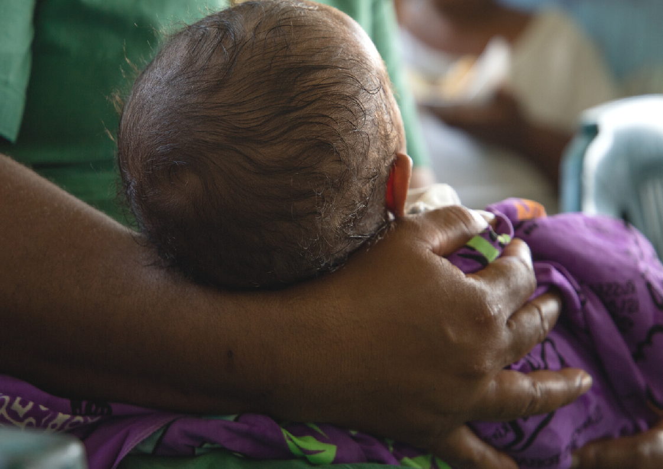
A sister cares for a baby at the Christian Care Centre.

Slide 12
Scandal & Honour
Ruth 3:1-18
Beneath the book of Ruth lie two stories of scandal; today, we deal with the first. Ruth is a Moabitess and in Genesis 19, we discover the origins of the Moabites. It is a devastating story that reveals Lot’s disregard for the welfare of his own daughters (Genesis 19:6-8), and their subsequent deception of their father at night, by whom they bear children (Genesis 19:30-38). The author of Genesis tells us that the sons born to them go on to become the ancestors of the Moabites and the Ammonites. This might seem an unusual way to start our third advent study, yet bear with me - we will discover some startling links.
after he has eaten and presumably had a bit to drink and then to ‘uncover his feet’.
Given the origins story, I can imagine the first hearers of Ruth thinking; ‘this is exactly what a Moabitess would do!’ Note the inference both of gender and race. This leads us to the very heart of the narrative, in which we see things from God’s surprising and unexpected perspective. Where one might expect to see scandal, the story of Ruth demonstrates honour. Boaz has already commended the honour with which Ruth has cared for her mother-in-law and now he himself responds with honour, and, with great urgency, will go about addressing the situation with integrity.
In our story, Ruth is instructed by her mother-in-law to approach Boaz at night

Slide 13
The book of Ruth invites us to see all things afresh from God’s perspective. God is doing something wonderfully redemptive in bringing a young Moabite woman into his plans for the world. We must beware of seeing scandal where, in fact, there is honour. Is this not the same when we get to the story of Christmas? Mary, a young, betrothed woman, becomes pregnant, and Joseph is not the father. He intends to divorce her quietly and, in doing so, to honour her. Yet God meets him and reveals that Mary’s pregnancy is no human scandal but rather the wondrous act of God.
seeing, we too need to apply that seeing as we seek God’s kingdom on earth as it is in heaven. This can mean suspending judgment and looking for the mercy of God, particularly in situations where people are vulnerable.
Response: Are there people you have preconceived ideas about? Ask God to give you fresh love and understanding for these people.
Lord God, help us to see all things through your eyes. Thank you that you are a redemptive God.
Grant your blessing on the work of Anglican Overseas Aid, as we work towards a world where women can participate with equality, dignity and respect. Amen
To embrace the gospel is to embrace a message that, on the surface, offends and appears scandalous. The gospel is a stumbling block to many, yet to those who believe it is life and salvation! Just as the gospel, which scandalises, brings new

Slide 14
A place to belong
‘It hasn’t been easy, but I’ve tried to live,’ 19-year- old Alice, who resides in Uganda, explains while
re-telling her harrowing story.
Finding herself pregnant at the age of 17, Alice (pictured with her child) was thrust into the responsibilities that come with parenthood and raising her child - devoid of both paternal and familial support.
Spending four days in a prison cell for attempting to escape her family home, Alice was left to reflect. Shamed and segregated, she struggled to find meaning.
Alice found herself not only isolated from her family but also from her community. Past aspirations to continue on to tertiary study and better her prospects were now seemingly unattainable.
However, two years on, access to the Wise Choices for Life (WCFL) program afforded Alice the support and empowerment to dream and aspire. Equipping her with fundamental communication and life skills, the program has become a crucial element in Alice’s development - not only as a young mother but as a vital member of her community.

Slide 15
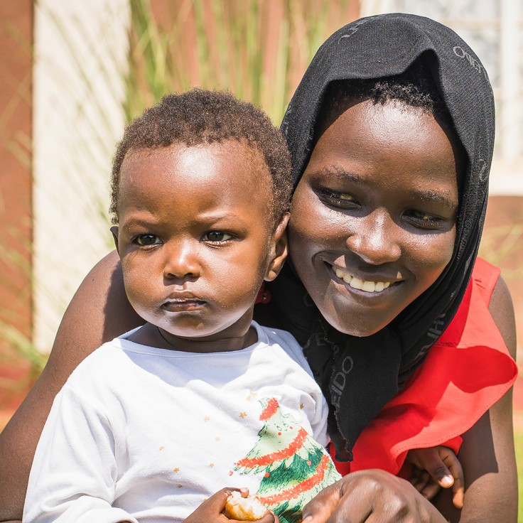
‘I see a bright future, I want to finish school and do a computer course,’ she reveals.
Having joined the program in 2022 after being approached by a WCFL instructor, Alice has been able to develop strong connections with other young women in her area and has found a new sense of hope and belonging.

Slide 16
Jesus’ Family Tree
Ruth 4:1-22
There is a second story of scandal that lies beneath the book of Ruth. In the midst of the Joseph narrative comes the perplexing story of Judah and Tamar in Genesis 38. The story features a practice that may seem strange to us, known as ‘levirate marriage’. It was the duty of the brother or next of kin to marry a widow who was without child to preserve a family line for her deceased husband.
came to realise that he himself was the father. In the end, he concedes, ‘she is more righteous than I’. Tamar lives and becomes the mother of twins, the younger being Perez, through whom the Messiah would come.
In the final chapter of Ruth, we discover that Boaz is a descendant of Perez.
Where Tamar suffered at the expense of
self-interested men, Ruth found Boaz, a descendant of Tamar who not only fulfilled his duty to her but who honoured and loved her. In this complex family tree, there is a sense of restoration and healing at this juncture. Boaz goes by the proper process, and with the exchange of a sandal, he embraces the role of kinsman redeemer, taking Ruth as his wife.
In that account, Tamar, a Canaanite, was denied the opportunity to conceive after being widowed. She was done an injustice by Onan and by her father-in-law Judah, who withheld his youngest son. Eventually, at great personal risk, Tamar deceived Judah, her father-in-law and conceived by him. Hearing that Tamar had fallen pregnant, Judah was prepared to have his daughter-in-law put to death until he
Near the end of Ruth, the people give a strange blessing: ‘May your family be like that of Perez, whom Tamar bore to Judah.’

Slide 17
A story of scandal is pronounced as a blessing! They had been able to perceive the blessing of God in the midst of a complex family history.
Ruth ends with a genealogy. In this love story of provision, refuge, honour, and faithfulness, God was preparing the way not only for David, a king after his own heart but also for the Messiah!
Both Tamar and Ruth feature in the genealogies of Jesus. God knew the plight Tamar faced as she preserved the ‘line of Judah’, and in the book of Ruth, we sense God delighting in Ruth the Moabitess, whose love for Naomi “is better than seven sons”.
In the book of Ruth, God’s redemptive story, fulfilled in Jesus, is deeply personal and concerns nothing less than the hope and transformation of the world.
Response: Whilst Anglican Overseas Aid responds to global concerns, the projects themselves are also deeply personal, as we partner to make a difference in the lives of people whom God loves.
Is there a particular area of AOA’s work that you are drawn to? How can you commit more of yourself to this, such as praying for women's equality?
Lord God, we thank you for the book of Ruth and for the amazing way it prepares us for the coming of Jesus at Christmas. Please help us to lead lives that resemble the redemptive, compassionate, merciful, and just love demonstrated in the lives of Ruth and Boaz, and ultimately fulfilled in the gift of your son Jesus, our savior and redeemer. Amen

Slide 18
Commitment to Community
Sai describes herself as brave, but she is more than brave; Sai is self-sacrificing, servant- hearted and optimistic.
Sai (pictured far left, with her family) lives in rural Cambodia, with her father who lives with a disability and her mother, who suffers from health issues. In grade four, Sai left school to work on her family's farm, generating enough income to support her loved ones, but sacrificing her own education.
Now 26, Sai is married, and her husband collects resin in the forest to provide an income. They continue to live with Sai’s parents and assist her family, but she also passionately supports her community. Sai volunteers with a malaria prevention program and is the deputy leader of her Savings Group, supported by AOA’s partner, Ponleu Ney Kdey Sangkhum (PNKS).
Attending leadership programs with other young people through PNKS has been a welcome retreat for Sai. She is also grateful for the training she has been able to

Slide 19
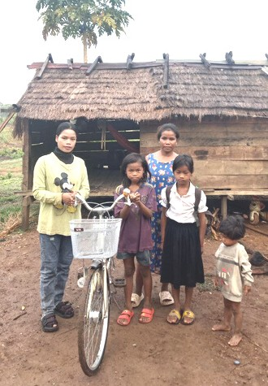
‘Knowledge through training delivery is a huge gift for us.’
undertake, explaining, ‘Knowledge through training delivery is a huge gift for us…[allowing us to] learn and take action.’
The training has helped Sai’s community have the courage to talk about issues and build positive relationships. Sai is committed to seeing her community emerge from poverty.

Slide 20
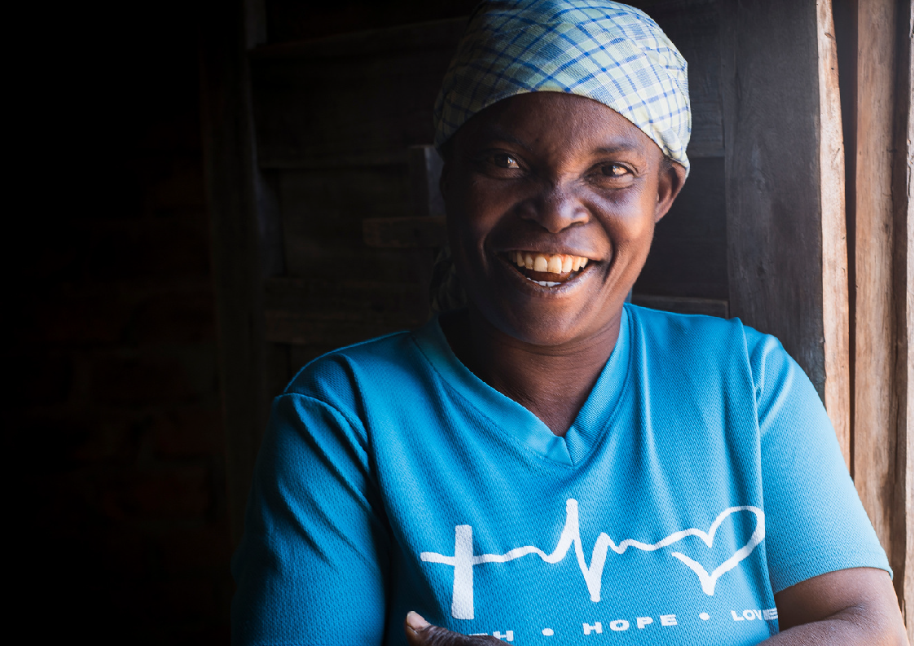
Find out more at: www.anglicanoverseasaid.org.au or call us on: 1800 249 880

